Slide 1
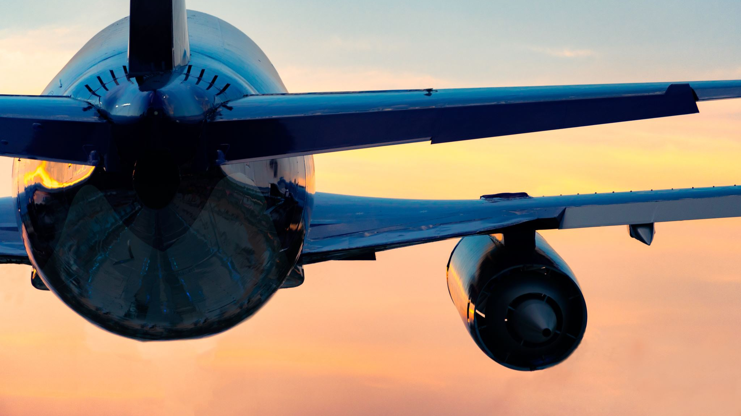
Analysis of Customer satisfaction of British Airways based on reviews on the internet
BA Data Science Job Simulation on Forage
Prepared by Nik Harith

Slide 2
Methodologies of analysis
The analysis was done by scraping the reviews on the website https://www.airlinequality.com/airline-reviews/british-airways/
Using python, the data was cleaned and exported into a .csv file
A total of 1000 entries of customer reviews was scraped
Visualisations were produced based on the cleaned data using the matplotlib library.
Additional library such as wordcloud and textblob were also used to help produce useful visualisations

Slide 3
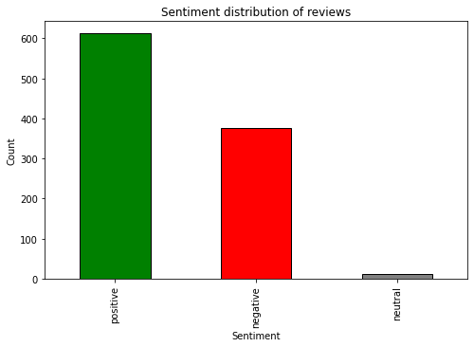
Customer sentiment analysis
The bar chart on the right shows us the number of sentiments categorized based on whether it is positive, negative or neutral.
Through this chart, we can see how many positive, negative or neutral reviews were given based on customers’ experience with British Airways.

Slide 4
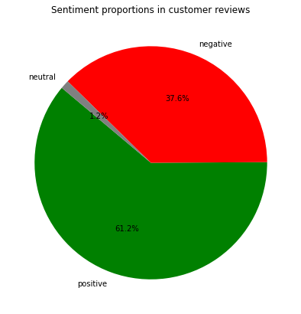
Customer sentiment analysis
With the same data using pie chart, we can analyze the proportions of the customer reviews based on their sentiments.
We can see the chunks of reviews that are either positive, negative or neutral out of all the customer reviews and in this case, there are more positive reviews over negative ones. However, the proportion of negative reviews is still quite big and could be addressed.

Slide 5
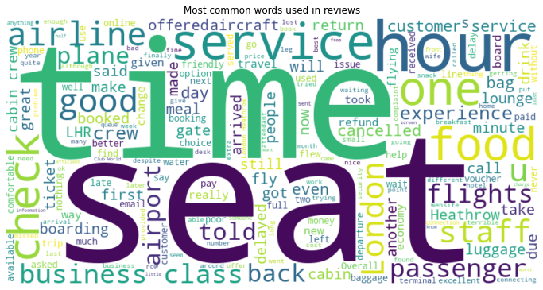
Common words used in reviews

Slide 6
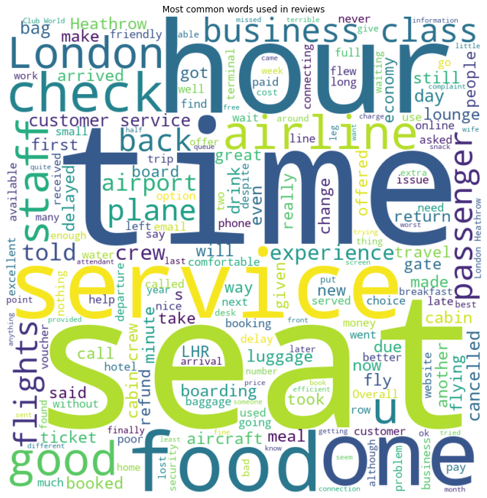
Common word analysis
By looking at common words used in customer reviews, we can identify the common aspects and concerns when customers interact or use any British Airways’ products or services.
This can be used to identify areas that can be focused or gaps that need to be filled in order to improve customer satisfaction in BA’s services and products

